Slide 1
MAFS 5440 Project 1 Submission Instruction
aifin.hkust@gmail.com

Slide 2
Kaggle Registration
According to the Kaggle discussion thread “SMS Account Verification” (https://www.kaggle.com/discussions/general/9883), Kaggle requires phone verification only once, the first time you attempt to submit to a competition.
If you see messages such as “Unable to verify phone number”, consult the first comment in the companion thread “Unable to Verify Phone Number” (https://www.kaggle.com/discussions/general/300902).

Slide 3
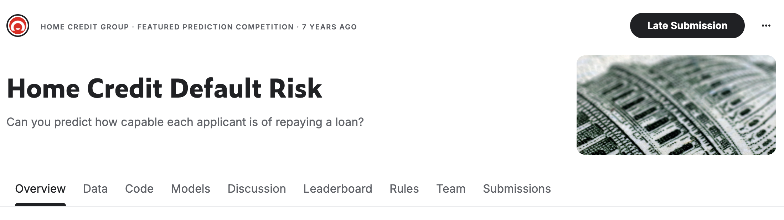
Access to Kaggle Resources
Kaggle competitions offer several resource sections: Code, Leaderboard, Data, and Discussion.

Slide 4
Accesse From the Code Section
The “Code” tab hosts all publicly shared notebooks (previously known as “Kernels”) written by other participants.
These notebooks include exploratory data analyses, feature engineering, and high‑performing model pipelines.
e.g. Logistic Regression, Random Forest, and LightGBM are used in this Home Credit Default Risk example.
https://www.kaggle.com/competitions/home-credit-default-risk/code
Notes:
Step‑by‑Step Guide:
- Log in to Kaggle.
- Open the Code tab of the competition.
- Use Filters at the top to sort notebooks:
Most Votes → usually surfaces SoTA‑level works.
Most Comments → highlights educational notebooks.
Recently Updated → shows active versions post‑competition.
- Click any notebook title to view the code, output, and discussion.
- To fork and run locally:
Click “Copy & Edit.”
Enable Internet or GPU in the notebook’s settings if required.
Execute the notebook to reproduce results.
Identifying SoTA:
Community consensus and upvotes indicate the most advanced methodologies. Keywords such as “stacked model,” “ensemble,” or “GBDT features” flag top performance.

Slide 5
Accessing From the Leaderboard
The Leaderboard ranks participants by their submitted predictions.
Top‑scoring users usually publish:
Final‑stage blending scripts
Feature importance analyse
Model training pipelines
https://www.kaggle.com/competitions/home-credit-default-risk/leaderboard
Notes:
Why This Matters:
This is the most direct way to discover real‑world SoTA implementations.
How to Use It:
Under the competition page, click the Leaderboar tab.
Use the Public Leaderboard (LB) to see open‑stage scores; private LB is revealed after closure.
Click a participant’s name to view their Kaggle profile—often linked to notebooks or GitHub repositories that disclose approaches.
Sort or search by Team name to identify top solutions, then cross‑reference them with notebooks in the Code tab.

Slide 6
Hints on your submission
By Combining the above Two Sources
Compare top scores on the Public Leaderboard.
Open the corresponding authors’ Code notebooks.
Synthesize their feature‑engineering or ensembling strategies.
Document dependencies (versions of LightGBM, XGBoost, CatBoost, etc.).
Notes:
Why This Matters:
This is the most direct way to discover real‑world SoTA implementations.
How to Use It:
Under the competition page, click the Leaderboar tab.
Use the Public Leaderboard (LB) to see open‑stage scores; private LB is revealed after closure.
Click a participant’s name to view their Kaggle profile—often linked to notebooks or GitHub repositories that disclose approaches.
Sort or search by Team name to identify top solutions, then cross‑reference them with notebooks in the Code tab.

Slide 7
Tips for Reproducibility
Always note the evaluation metric
AUROC for this Home Credit Default
Use git to preserve version history
Rather than copy paste code snippets
If you use jupyter notebooks, commit successful experimenal outputs to github.
The commit ID would verify your historical experiment results.
Notes:
Why This Matters:
This is the most direct way to discover real‑world SoTA implementations.
How to Use It:
Under the competition page, click the Leaderboar tab.
Use the Public Leaderboard (LB) to see open‑stage scores; private LB is revealed after closure.
Click a participant’s name to view their Kaggle profile—often linked to notebooks or GitHub repositories that disclose approaches.
Sort or search by Team name to identify top solutions, then cross‑reference them with notebooks in the Code tab.

Slide 8
Easy Chair Instruction
This is the step‑by‑step guidance for using EasyChair.org to handle paper submissions and peer reviews.
EasyChair is an online system that supports the full lifecycle of academic conference management, including:
Call for Papers (CFP) publication
Author submissions
Reviewer assignment & evaluation
Decision making
Proceedings management
Notes:
Target Audience
Authors: Researchers who need to submit academic papers to conferences.
Reviewers: Scholars responsible for evaluating submissions.
Chairs: Conference organizers managing the platform’s workflow.

Slide 9
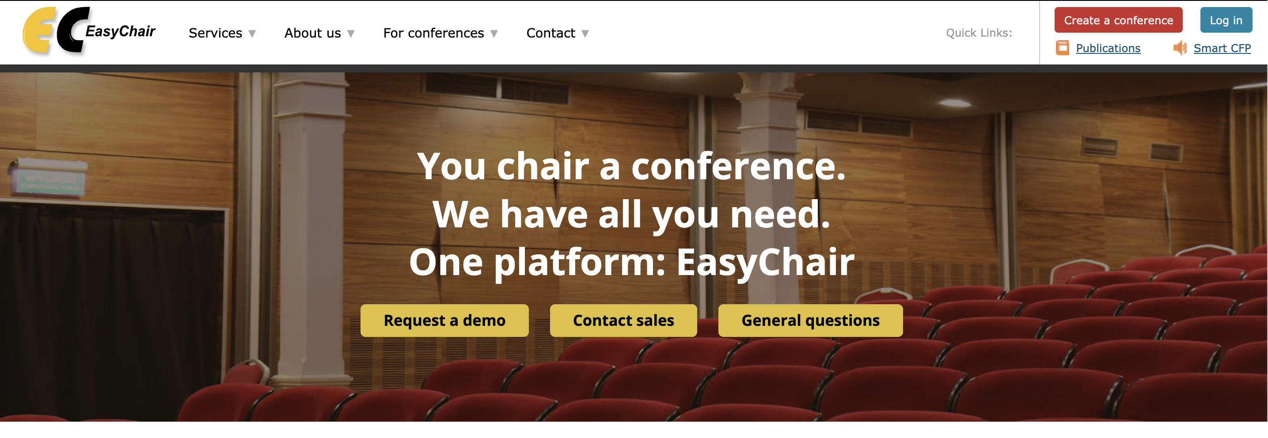
Creating an EasyChair Account
Step 1: Go to the EasyChair Homepage
Open your browser and go to https://easychair.org.
Click on “Sign Up for an Account”.

Slide 10
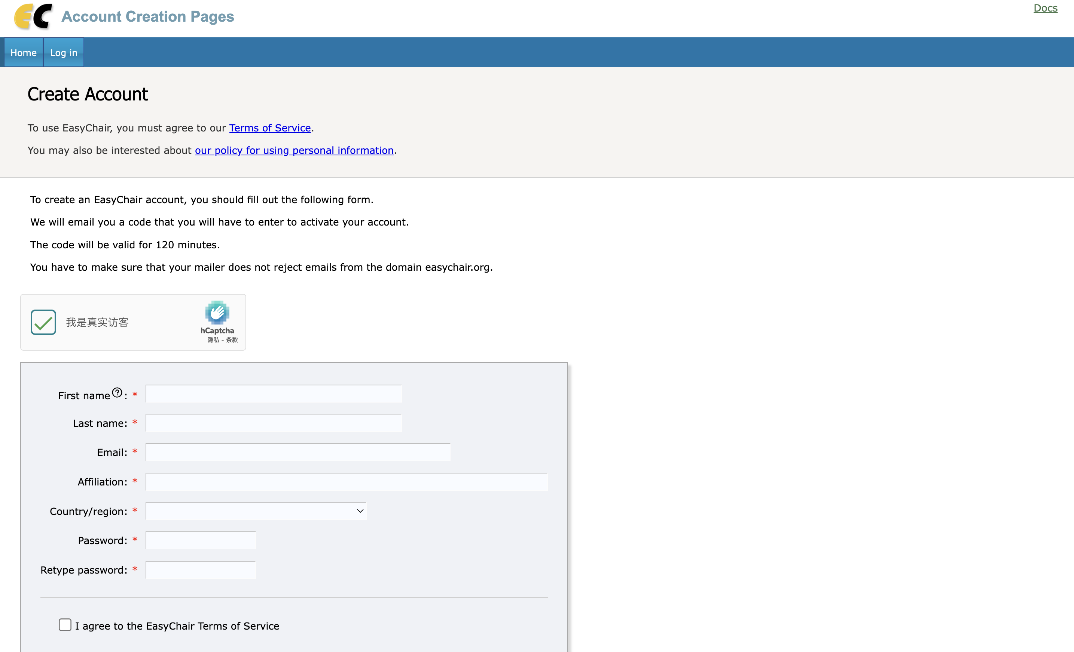
Creating an EasyChair Account
Step 2: Complete Your Profile
Enter your name, affiliation, and country.
Choose a username and password.
Check the box agreeing to EasyChair’s terms of service.
Step 3: Conifrm Verification Email
Provide a valid email address.
You’ll receive a verification email.
Click the link in the email to confirm.

Slide 11
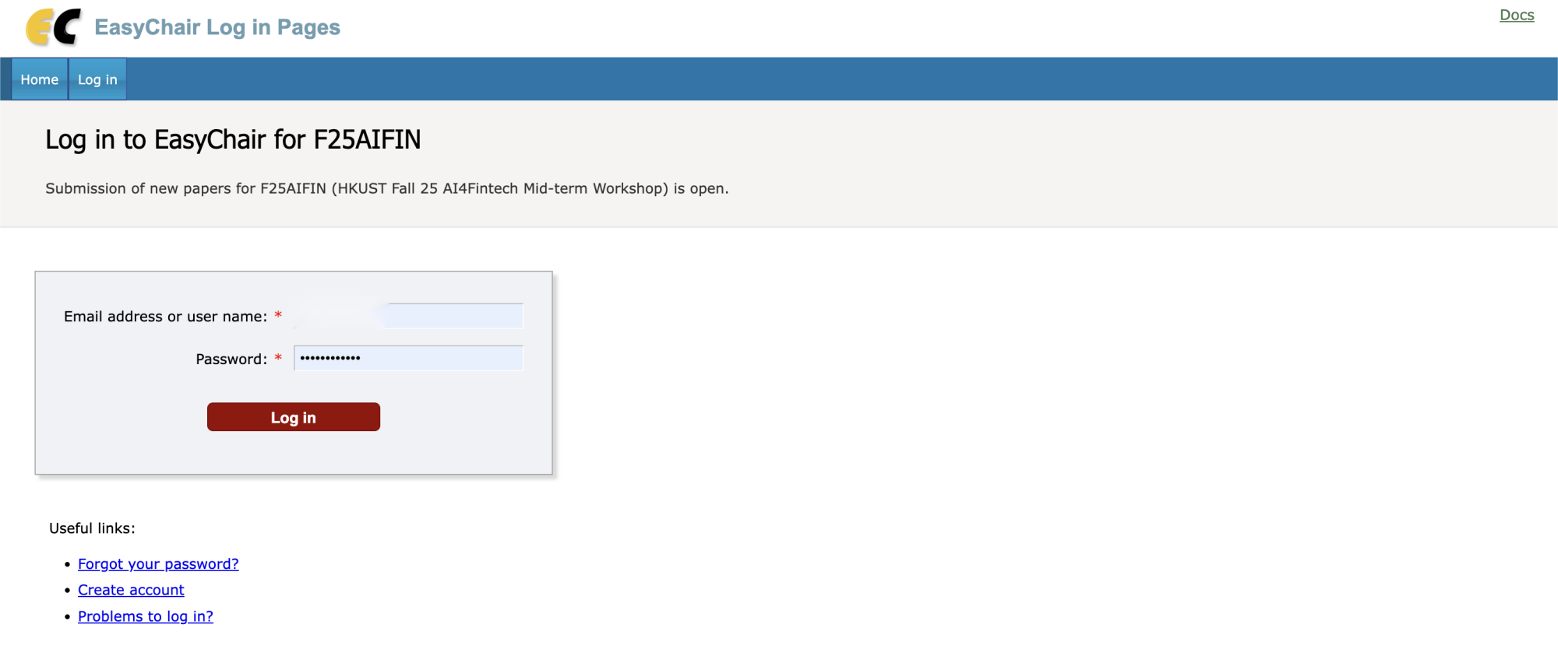
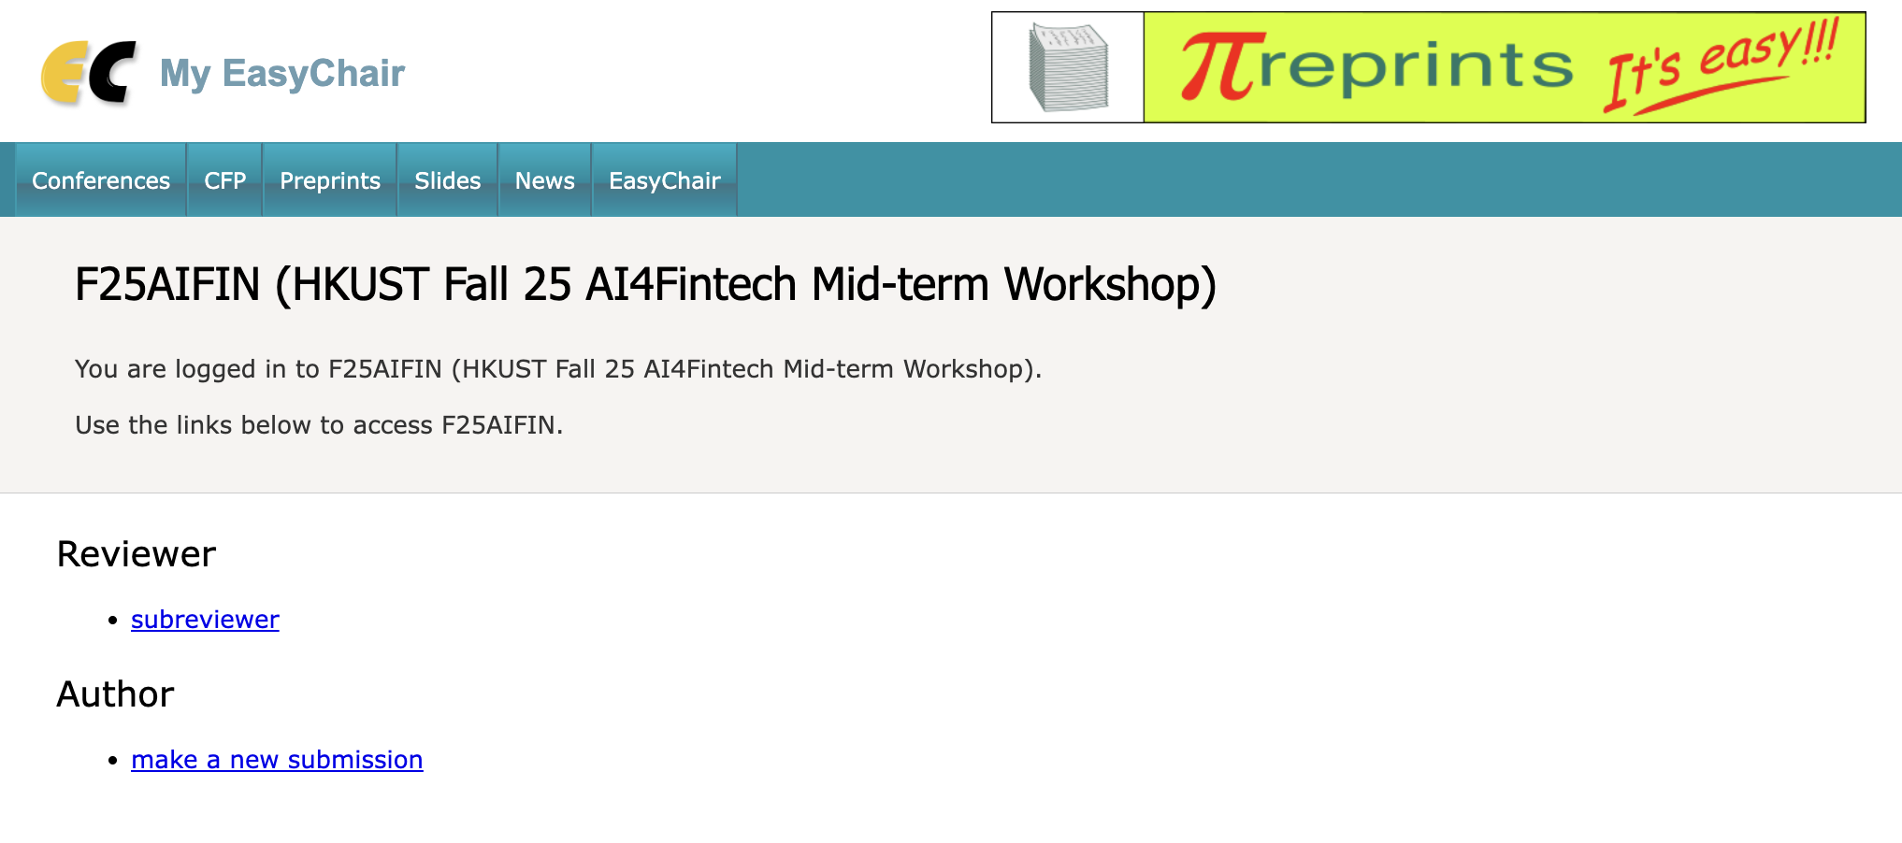
Accessing the Conference
Once you have an account, login to https://easychair.org/my/conference?conf=f25aifin.
Under “My Conferences,” click “Enter as Author,” or “Enter as Reviewer,” depending on your role.

Slide 12
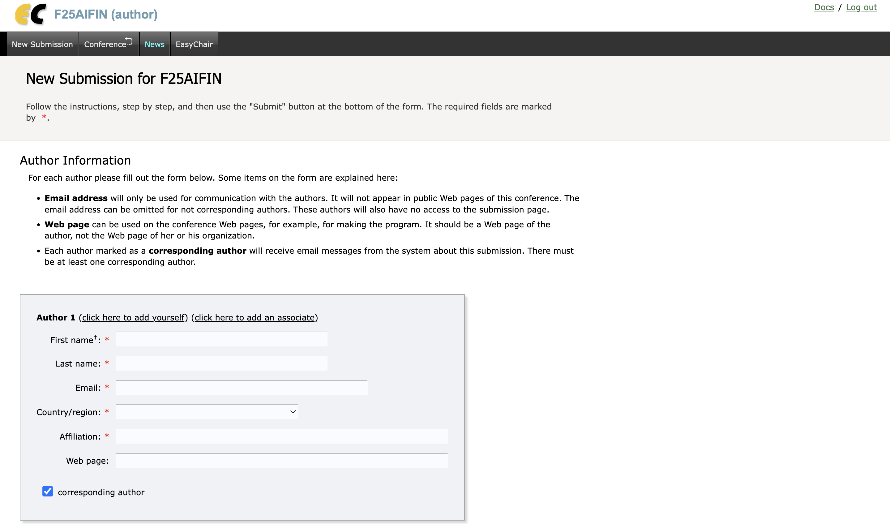
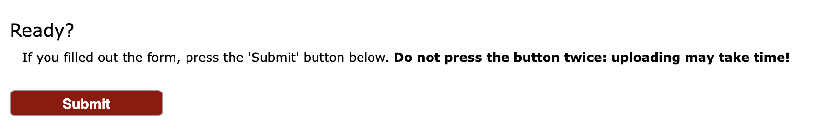
Author Interface Overview
After entering a conference as an Author, you’ll see the following menu items:
Add authors: make sure teamleader input every member as author for your submission.
Input Title and Abstract: please put a link to the github repo of your code/notebooks at the end of the abstract.
Keywords: for assigning reviewers
PDF: upload your report or ppt in pdf format here.
Submit: after completing above form, click this button

Slide 13
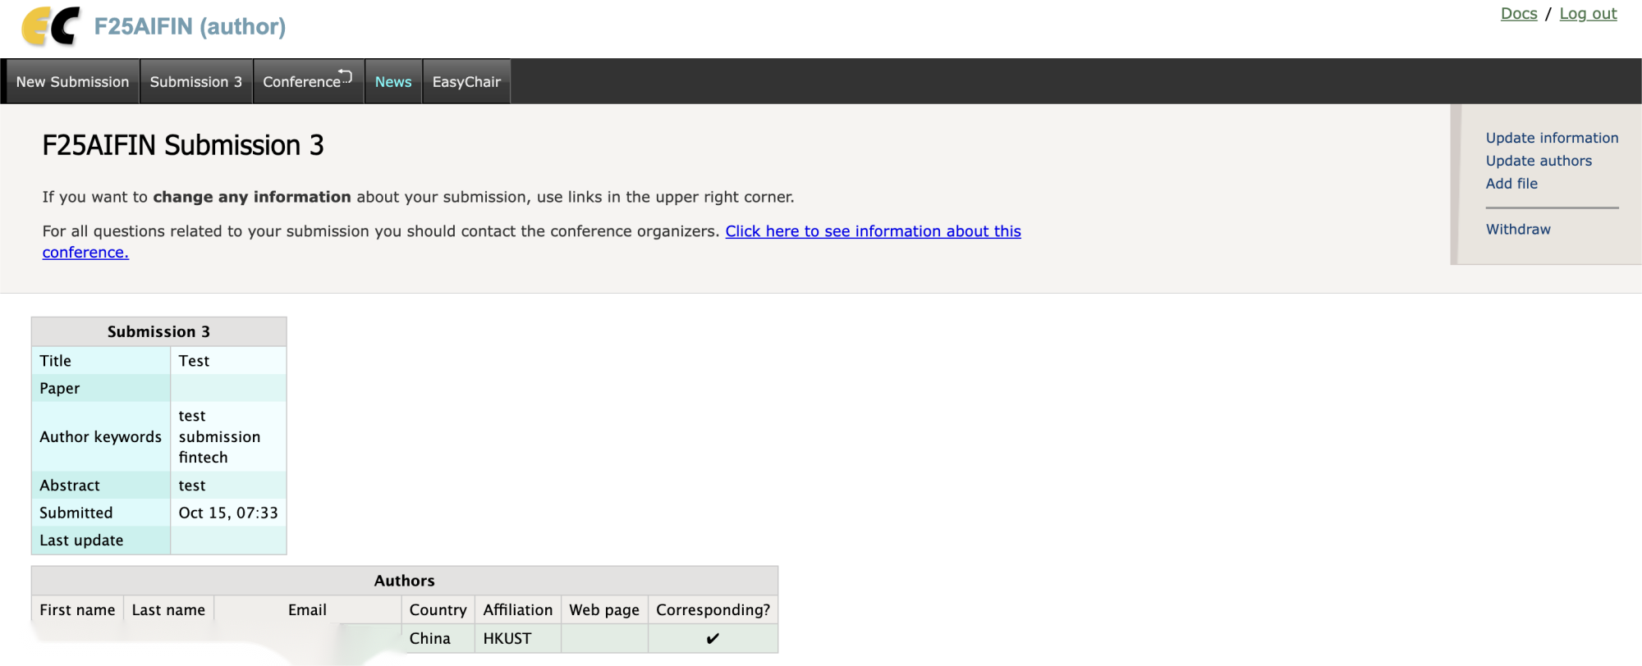
Managing Submitted Papers
After click submit button, you can update your submission through banner:

Slide 14
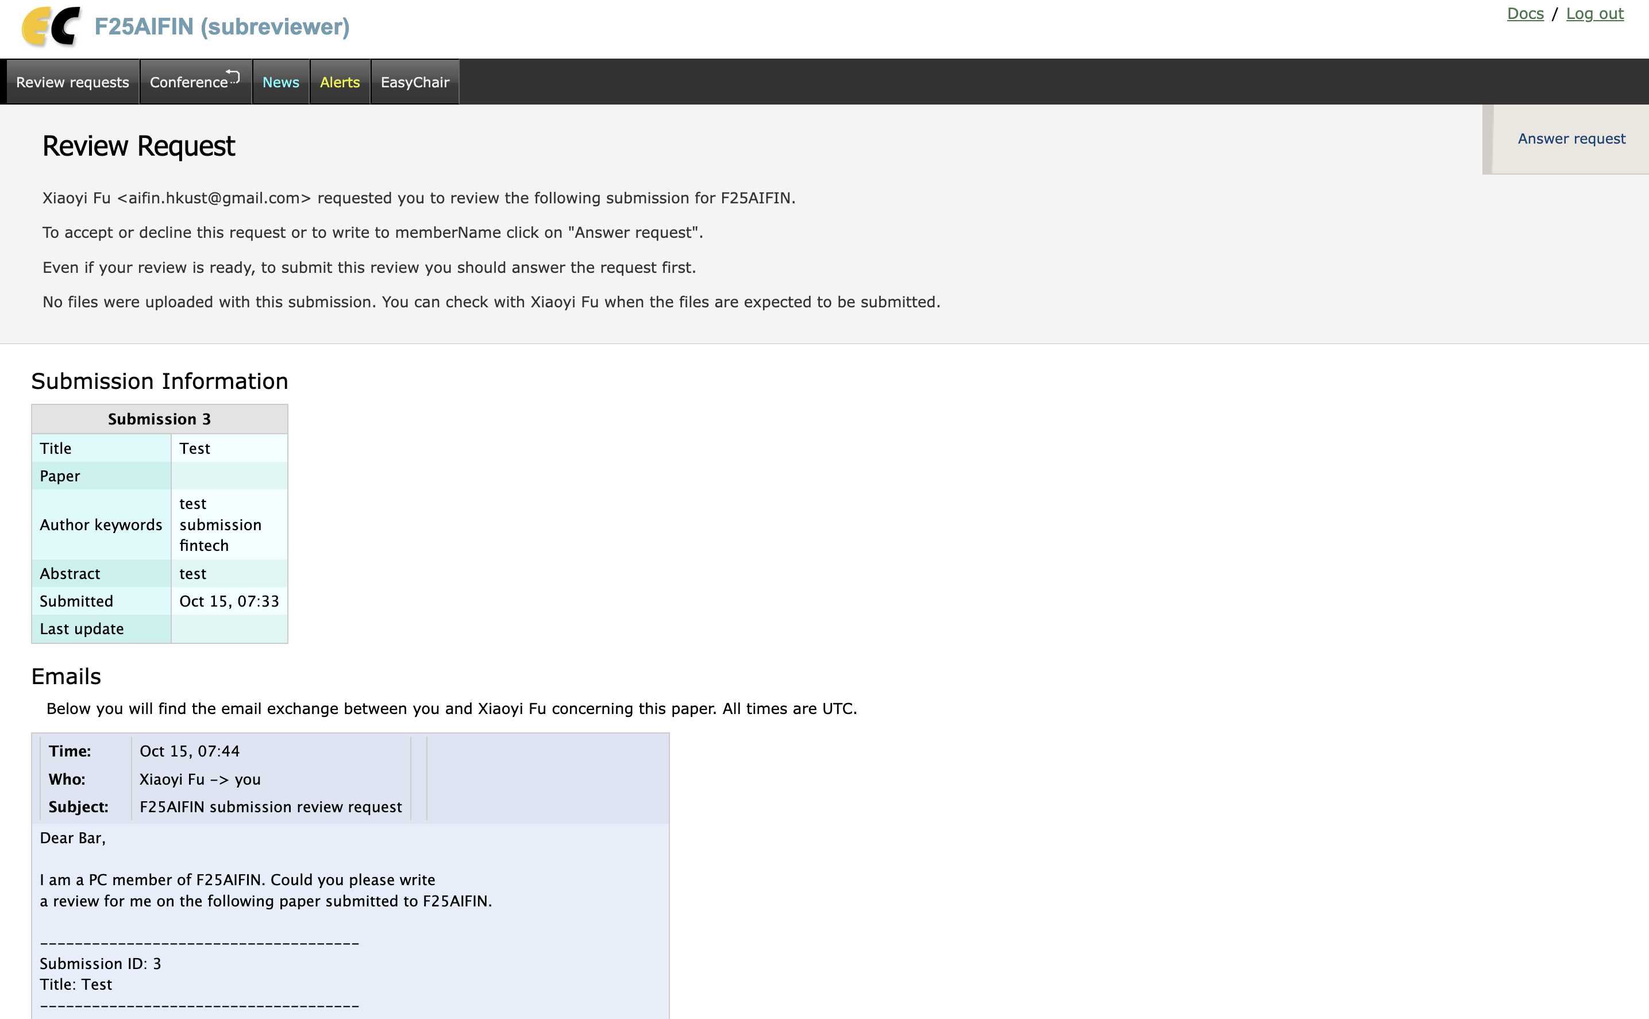
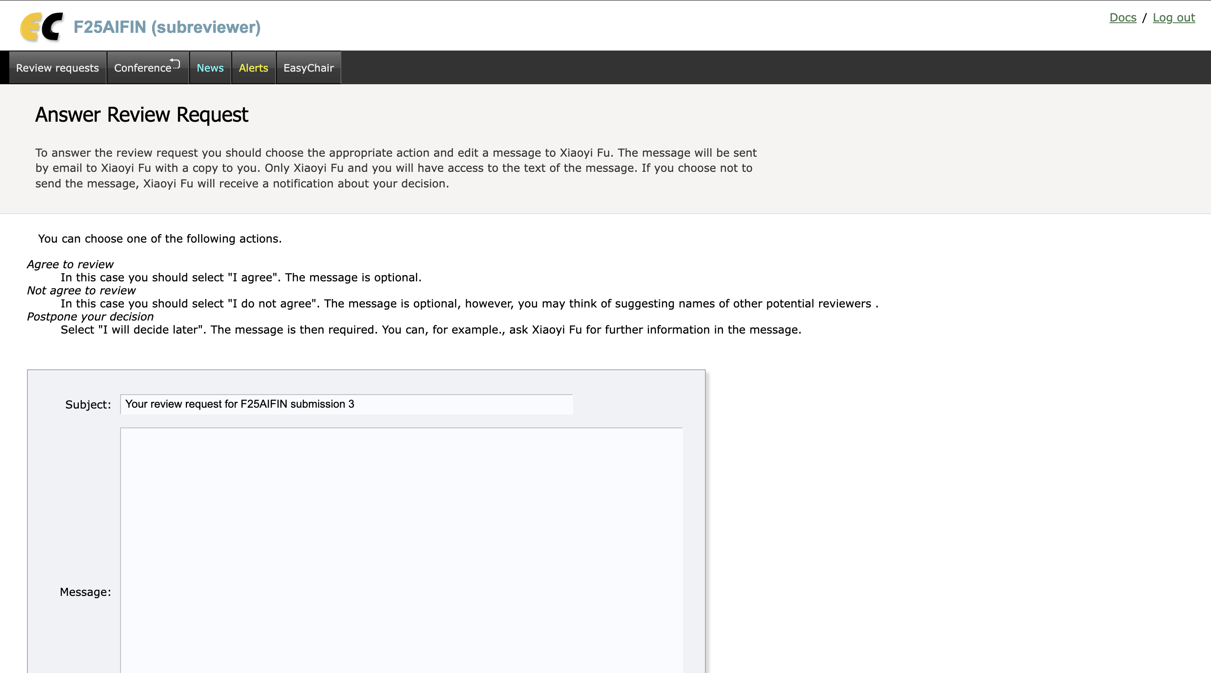
Reviewer’s Duty
Every student (NOT team) would be assigned around 1 or 2 reports to review.
After submission deadline, you would receive an an email containing a link to open review request. You will need to answer review request by clicking upper right button.

Slide 15
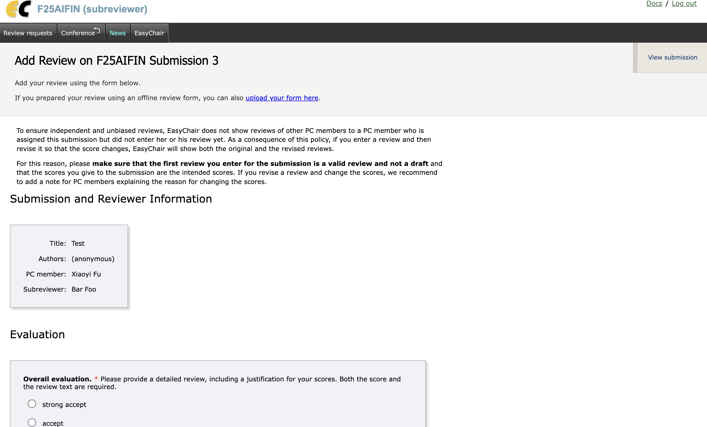
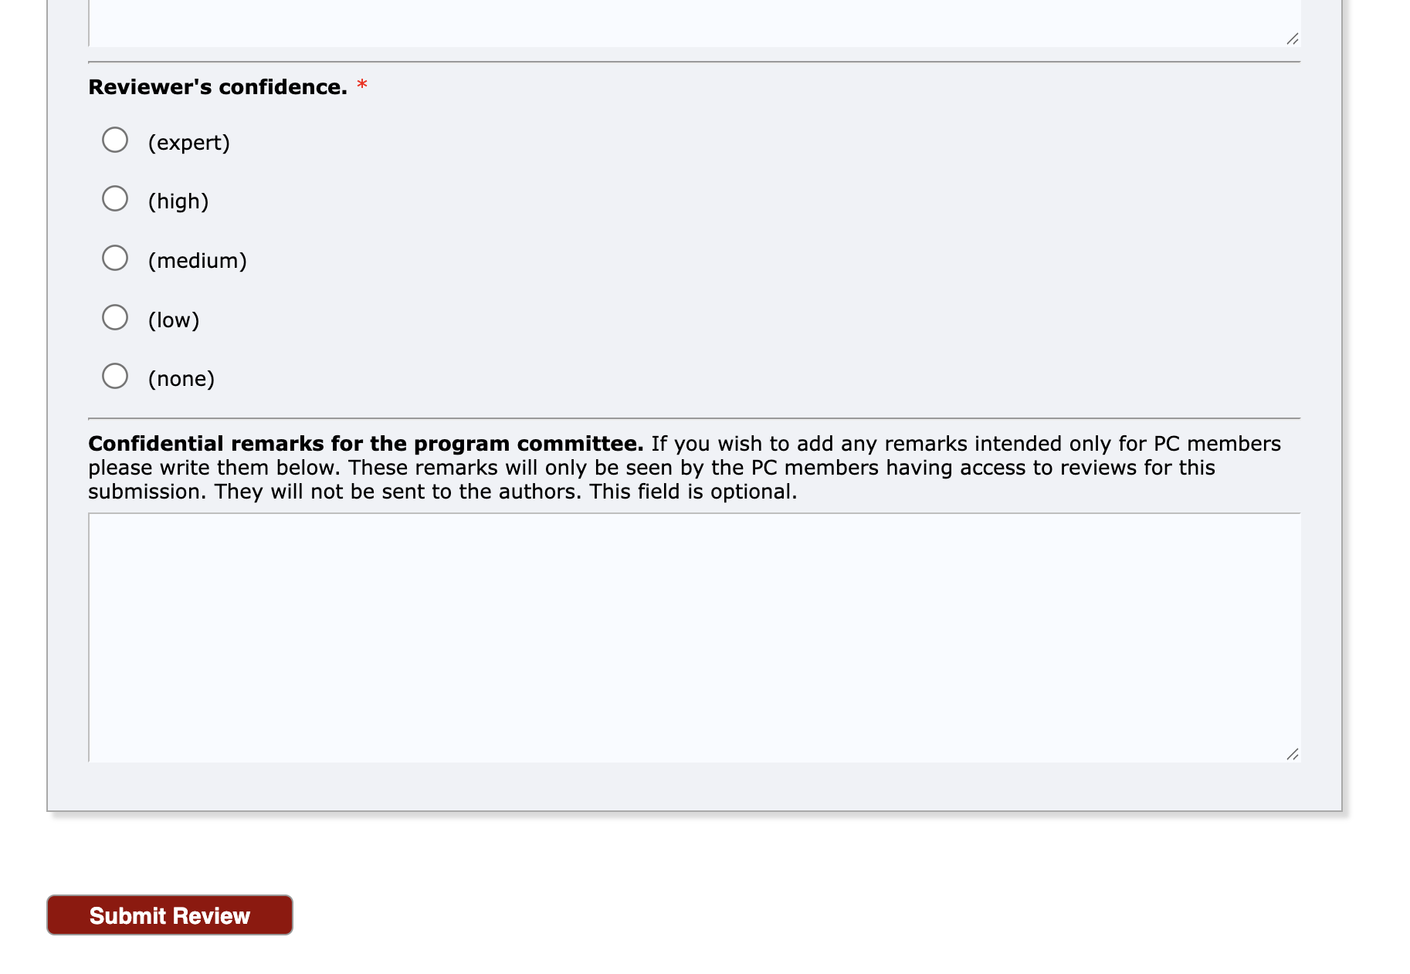
Writing and Submitting Reviews
Once you accepted by answering the request, the upper right corner button become ‘sumbit reivew’.
Enter the review form it may include:
Overall Evaluation (e.g., Strong Accept → Reject)
Confidence in Review
Summary of Paper
Strengths
Weaknesses
Detailed Comments
Confidential Remarks for Chairs Only

Slide 16
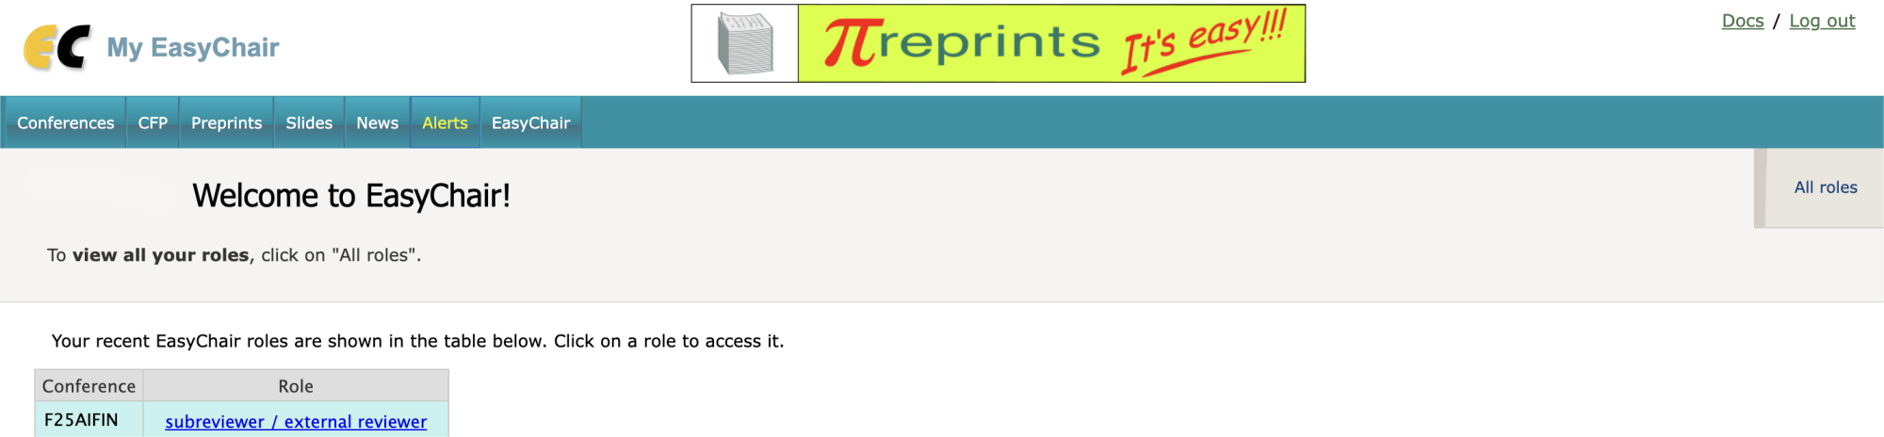
Double-check Your Reviews
You can log in easychair again to confirm your reviews.
Login and enter F25AIFIN again, you’ll now see “Subreviewer” options.

